Slide 1

Group 3
Richa Dalwadi
Tanveer Syed
Ha Tran
Shivangi Sharma

Slide 2

Executive Summary
Provide a comprehensive analysis of the Airbnb market in Downtown Atlanta and the competitive landscape at 300 Peachtree, Atlanta.
Conduct qualitative market research and comparative analysis of successful Airbnbs.
Key findings highlight successful strategies of top-performing Airbnbs, trends in occupancy rates, average daily rates (ADR), and the impact of seasonality.
Recommendations include optimizing pricing strategies based on seasonal trends, implementing best practices from successful competitors, and identifying profitable markets for future investment.
This Photo by Unknown Author is licensed under CC BY-NC-ND

Slide 3
Business Problem
What does the Airbnb market look like in Downtown Atlanta?
Qualitative Market research
How many Airbnb competitors at 300 Peachtree, Atlanta?
Airbnb competition and pricing strategy at 300 Peachtree, Atlanta?
What are the Airbnb performances
What are the key strategies of the most successful Airbnbs (compared with other competitors) in this particular area?
Deep dive on a few Airbnbs that you believe are most successful or insightful.

Slide 4


300 Peachtree St, Atlanta
Peachtree Towers Condominiums was the tallest residential building in Atlanta at the time, standing 23 stories tall and reaching a height of 240 feet.
The building consists of 330 residential condominiums, including studio, one, and two-bedroom units.

Slide 5
How does Atlanta Look like

Slide 6
Let’s go Deeper

Slide 7
More Deeper to the Actual Problem

Slide 8
Common type of Rental Stays

Slide 9
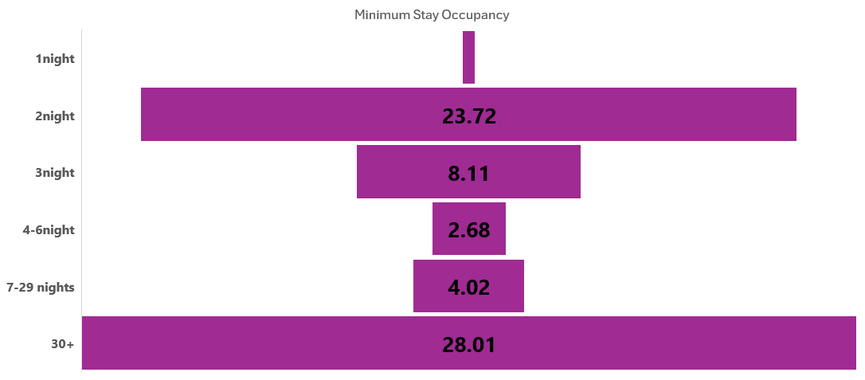
Understanding Airbnb
0.4

Slide 10
For how long do people stay

Slide 11
How are the properties Given

Slide 12
How did it work for Airbnb
No. of Bedroom | No. of Bathroom | Max. no. of Guest | Occupancy rate | Average Daily Rate ($) | Projected Revenue ($)
2 | 2 | 4 | 59% | 203 | 43600
1 | 1 | 2 | 55% | 137 | 27300
3 | 3 | 6 | 75% | 447 | 122700

Slide 13
What about its competitor VRBO
No. of Bedroom | No. of Bathroom | Max. no. of Guest | Occupancy rate | Average Daily Rate in $ | Projected Revenue in $
4 | 4 | 8 | 82% | 536 | 160900
5 | 5 | 10 | 47% | 652 | 112100
6+ | 6+ | 15+ | 69% | 763 | 191000

Slide 14
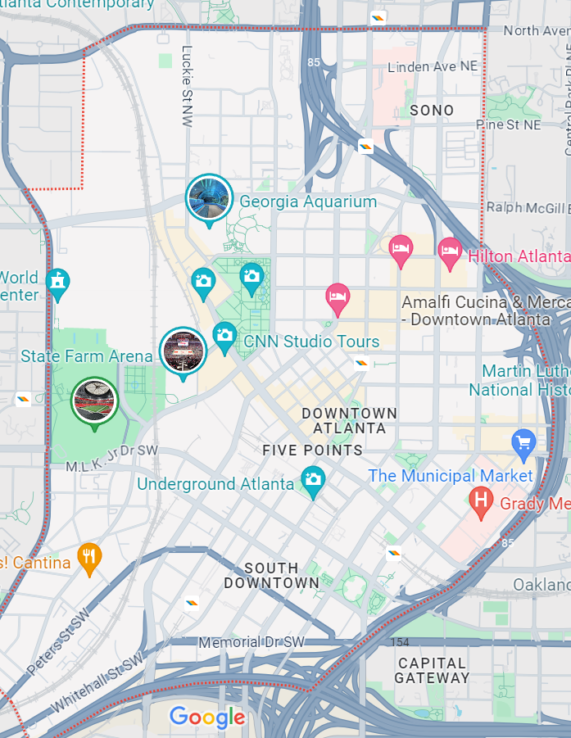
Downtwon Atlanta

Slide 15
Rules and Regulations for Atlanta Airbnb
Residency Requirement: To operate a short-term rental in Atlanta, the owner must be a resident of the city. This means that non-residents cannot legally operate short-term rentals in Atlanta.
Property Ownership Cap: Each resident is limited to owning and operating a maximum of two short-term rental properties. Of these, one must be the owner’s primary residence.
Licensing: Owners must obtain an annual short-term rental license for each property they operate. The license fee is $150 per year.
Taxes: In addition to the license fee, owners are required to pay an 8% tax on rental income. This is in line with the city's efforts to regulate and benefit from the short-term rental market.

Slide 16
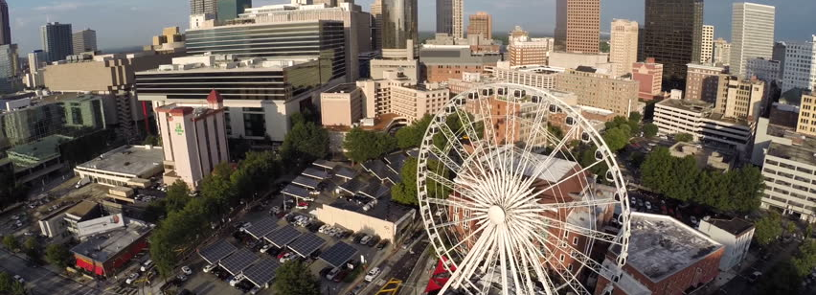
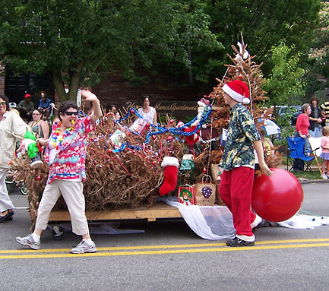
Which time of the Year are they sold out and since when
July 10th -16th
Christmas in July brawl
Peachstate block party
August 29th – Sep 2nd
Labor day weekend
Black Pride Parade weekend
Peachtree festival
This Photo by Unknown Author is licensed under CC BY-SA-NC

Slide 17

Companies in Atlanta
Coca-Cola
UPS
Home Depot
Delta Air Lines
Georgia Pacific
Spanx Activewear
This Photo by Unknown Author is licensed under CC BY-NC

Slide 18
Future Research
Use the given dataset, and historical data, to identify trends in occupancy rates, ADR, and overall market performance.
Perform benchmarking of key metrics against competitors in the area.
Plot time series data for occupancy rates and ADR, and Use moving averages and trend lines to highlight long-term trends.
Gather insights into market trends, guest preferences, and the competitive landscape in Downtown Atlanta and other profitable markets across the US.
Apply seasonal decomposition on historical occupancy and ADR data to separate trend, seasonality, and residual components.

